Slide 1
MR Factors CSS and LS
Mauro Acuña, Risk team

Slide 2
CSS Mean Reversion Factors
Aligne bases the daily MtM option valuation on Kirk formula (find Kirk approximation in appendix 2).
CSS prices are mean reverting (yield in T not independent from yield in T-1), the process is not as “explosive” as a random walk and square root of time-influence is partially offset by a reversion to the mean.
The mean reversion of the CSS is implied in the Merit Order simulations.
We account for that mean reversion adjusting the Kirk valuation of Aligne.

Slide 3

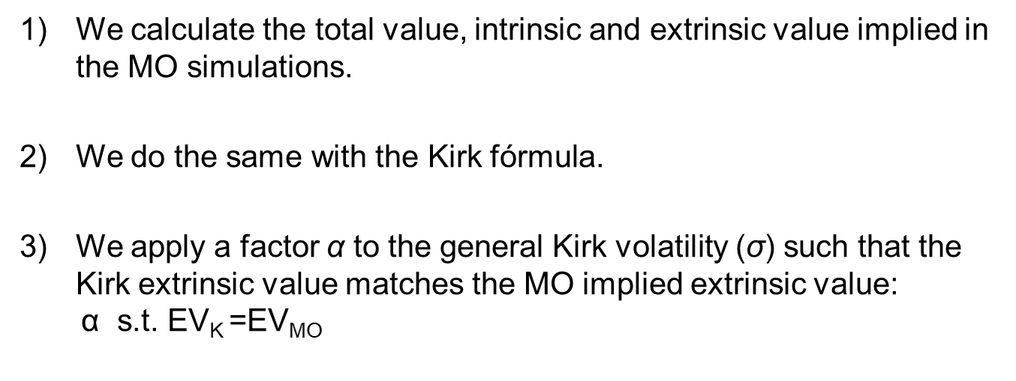
Steps
We calculate the total value, intrinsic and extrinsic value implied in the MO simulations.
2) We do the same with the Kirk fórmula.
3) We apply a factor α to the general Kirk volatility ($\text{σ}$) such that the Kirk extrinsic value matches the MO implied extrinsic value: $\text{α} \text{s}\text{.}\text{t}\text{.} \text{EV}\text{K} \text{=}\text{EVMO}$

Slide 4
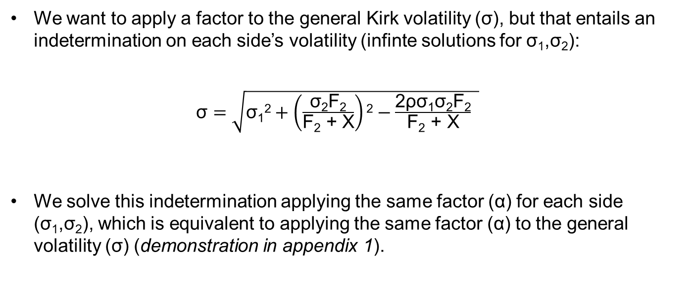
Note
We want to apply a factor to the general Kirk volatility (σ), but that entails an indetermination on each side’s volatility (infinte solutions for $\text{σ}\text{1}$,$\text{σ}\text{2}$):
σ $=\sqrt{\text{σ}\text{1}\text{2}+\left(\frac{\text{σ}\text{2}\text{F}\text{2}}{\text{F}\text{2}\text{ + }\text{X}}\right)\text{2}−\frac{\text{2}\text{ρσ}\text{1}\text{σ}\text{2}\text{F}\text{2}}{\text{F}\text{2}\text{ + }\text{X}} }$
We solve this indetermination applying the same factor (α) for each side (σ₁,σ₂), which is equivalent to applying the same factor (α) to the general volatility (σ) (demonstration in appendix 1).

Slide 5

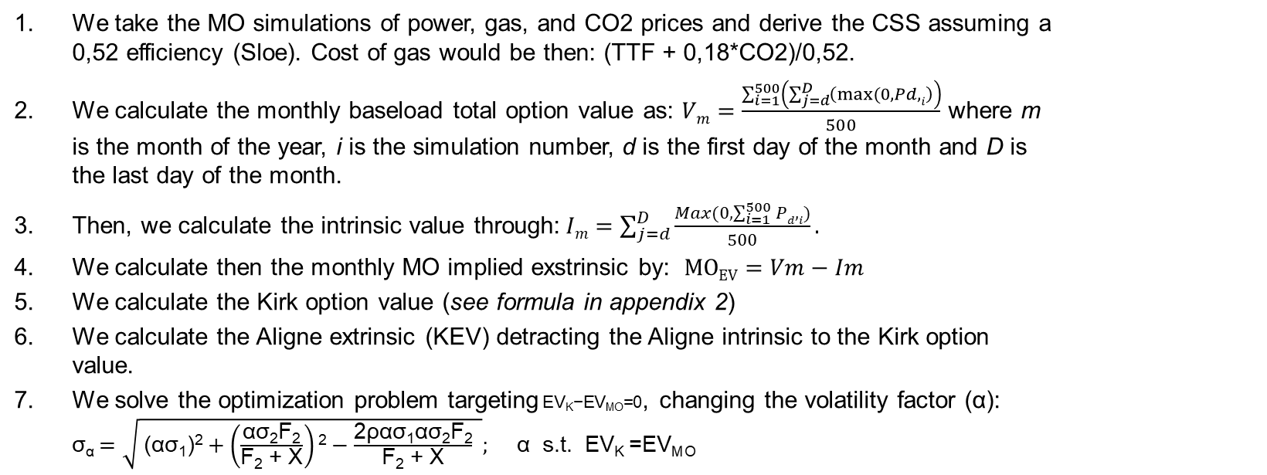
Detailed Steps
We take the MO simulations of power, gas, and CO2 prices and derive the CSS assuming a 0,52 efficiency (Sloe). Cost of gas would be then: (TTF + 0,18*CO2)/0,52.
We calculate the monthly baseload total option value as: $Vm=\frac{\sum_{i=1}^{500}{\left(\sum_{j=d}^{D}{\left(max⁡(0,Pd,i\right)}\right)}}{500}$ where m is the month of the year, i is the simulation number, d is the first day of the month and D is the last day of the month.
Then, we calculate the intrinsic value through:$Im=\sum_{j=d}^{D}{\frac{Max(0,\sum_{i=1}^{500}{Pd,i})}{500}}.$
We calculate then the monthly MO implied exstrinsic by: $MOEV=Vm−Im$
We calculate the Kirk option value (see formula in appendix 2)
We calculate the Aligne extrinsic (KEV) detracting the Aligne intrinsic to the Kirk option value.
We solve the optimization problem targeting$\text{EV}\text{K}\text{−}\text{EV}\text{MO}\text{=}$0, changing the volatility factor (α): σ_{α} $=\sqrt{ \text{(}\text{ασ}\text{1}\text{)}\text{2}+\left(\frac{\text{ασ}\text{2}\text{F}\text{2}}{\text{F}\text{2}\text{ + }\text{X}}\right)\text{2}−\frac{\text{2}\text{ρασ}\text{1}\text{ασ}\text{2}\text{F}\text{2}}{\text{F}\text{2}\text{ + }\text{X}} }; \text{α} \text{s}\text{.}\text{t}\text{. }\text{EVK}\text{ =}\text{EVMO}$

Slide 6



Appendix 1 demonstration:
Kirk general volatility:
σ $=\sqrt{\text{\{}\text{σ}\text{1}\text{2}+\left(\frac{\text{σ}\text{2}\text{F}\text{2}}{\text{F}\text{2}\text{ + }\text{X}}\right)\text{2}−\frac{\text{2}\text{ρσ}\text{1}\text{σ}\text{2}\text{F}\text{2}}{\text{F}\text{2}\text{ + }\text{X}}\text{ \}}}$ eq.1
Applying a factor to each side:
σ_{α} $=\sqrt{\text{\{(}\text{ασ}\text{1}\text{)}\text{2}+\left(\frac{\text{ασ}\text{2}\text{F}\text{2}}{\text{F}\text{2}\text{ + }\text{X}}\right)\text{2}−\frac{\text{2}\text{ρασ}\text{1}\text{ασ}\text{2}\text{F}\text{2}}{\text{F}\text{2}\text{ + }\text{X}}\text{ \}}}$
Operating:
σ_{α} $=\sqrt{\text{\{}\text{α}\text{2 }\text{σ}\text{1}\text{2}+\text{α}2\left(\frac{\text{ασ}\text{2}\text{F}\text{2}}{\text{F}\text{2}\text{ + }\text{X}}\right)2−\text{α}2\frac{\text{2}\text{ρσ}\text{1}\text{σ}\text{2}\text{F}\text{2}}{\text{F}\text{2}\text{ + }\text{X}}\text{ \}}}$ →
σ_{α} $=\sqrt{\text{α}\text{2}\text{\{}\text{σ}\text{1}\text{2}+\left(\frac{\text{σ}\text{2}\text{F}\text{2}}{\text{F}\text{2}\text{ + }\text{X}}\right)2−\frac{\text{2}\text{ρσ}\text{1}\text{σ}\text{2}\text{F}\text{2}}{\text{F}\text{2}\text{ + }\text{X}}\text{ \}} }$ →
→ σ_{α} $=\text{α}\sqrt{ \text{\{}\text{σ}\text{1}\text{2}+\left(\frac{\text{σ}\text{2}\text{F}\text{2}}{\text{F}\text{2}\text{ + }\text{X}}\right)2−\frac{\text{2}\text{ρσ}\text{1}\text{σ}\text{2}\text{F}\text{2}}{\text{F}\text{2}\text{ + }\text{X}}\text{ \}}}$ → eq.1 → σ_{α} $=\text{ασ}$

Slide 7
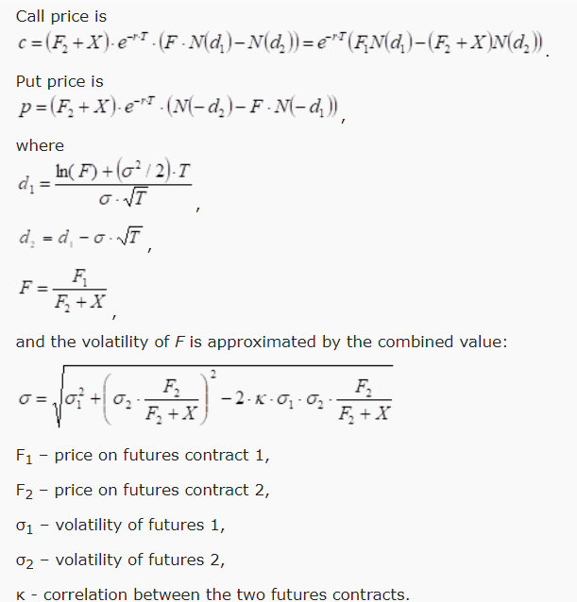
Appenix 2: Kirk Approximation
Kirk approximation for spread options:
Source: Kirk’s Approximation (cqg.com)
Note: X – Strike (in this case 0)

Slide 8

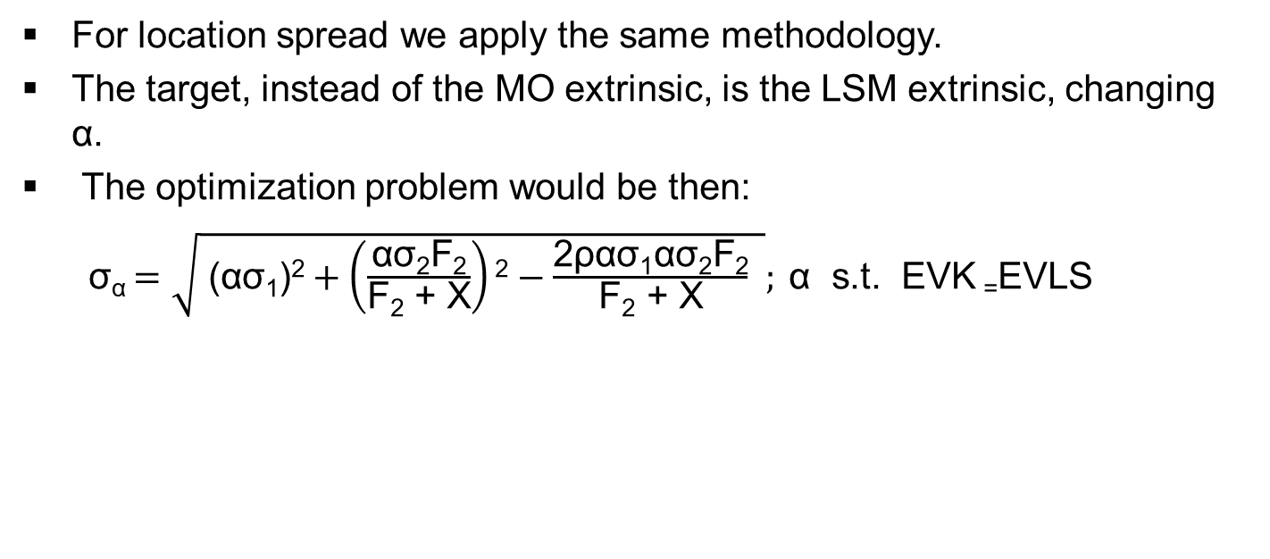
Location Spread
For location spread we apply the same methodology.
The target, instead of the MO extrinsic, is the LSM extrinsic, changing $\text{α}$.
The optimization problem would be then:
σ_{α} $=\sqrt{ \text{(}\text{ασ}\text{1}\text{)}\text{2}+\left(\frac{\text{ασ}\text{2}\text{F}\text{2}}{\text{F}\text{2}\text{ + }\text{X}}\right)\text{2}−\frac{\text{2}\text{ρασ}\text{1}\text{ασ}\text{2}\text{F}\text{2}}{\text{F}\text{2}\text{ + }\text{X}} }; \text{α} \text{s}\text{.}\text{t}\text{. }\text{EVK}\text{ =}\text{EVLS}$

Slide 9
Files
Python Script MO: C:\Users\D110148\OneDrive - pzem\Main\Risk Management OTS\Persoonlijke Mappen\Mauro\Script4MeanReversionFactors.ipynb
Template for MR Factors calculation: C:\Users\D110148\OneDrive - pzem\Main\Risk Management OTS\Persoonlijke Mappen\Shared\Mean Reversion Factor Estimation Template.xlsx
Gas location Spread valuations: I:\BU Portfolio Analytics\Shared\Gas Location Spread Valuations

